Slide 1
Windows form programming

Slide 2
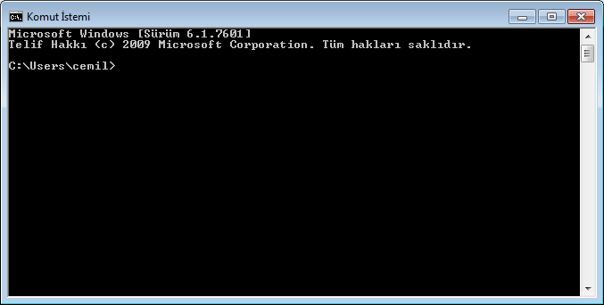

Slide 3
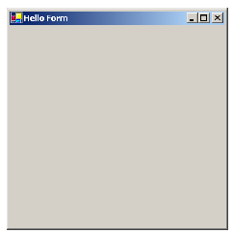

Slide 4
namespace MyNamespace
{
public class MyForm : System.Windows.Forms.Form
{
public MyForm()
{
this.Text = "Hello Form";
}
public static void Main()
{
System.Windows.Forms.Application.Run(new MyForm());
}
}
}

Slide 5
we define a class called MyForm that inherits from the Form class, which is found in the System.Windows.Forms namespace. The period notation is used to separate namespaces and classes, so that the complete, or fully qualified, name for the class is System.Windows.Forms.Form.
namespace MyNamespace
{
public class MyForm : System.Windows.Forms.Form
{
. . .
}
}
The Form class is the cornerstone of Windows-based applications in .NET. It represents
any type of window in an application, from dialog boxes to MDI (Multiple Document Interface) client windows. The Form class provides the ability to display, place controls within, and interact with an application window.

Slide 6
Constructors and methods
Take another look at the declaration of our MyForm class. Note how two members of
this class are defined, namely the MyForm constructor and the Main method. Both members are declared as public, as is the class MyForm.
public class MyForm : System.Windows.Forms.Form
{
public MyForm() // constructor
{
this.Text = "Hello Form";
}
public static void Main()
{
System.Windows.Forms.Application.Run(new MyForm());
}
}

Slide 7
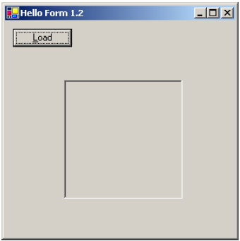
Adding controls
Let’s make our program a little more interesting by adding some controls. Throughout the course of the book, we will be building a photo viewing application, so let’s add a button for loading an image file, and a box where the image can be displayed.
When we are done, our form will look like figure

Slide 8
namespace MyNamespace
{
using System;
using System.Windows.Forms;
public class MyForm : Form
{
private Button btnLoad;
private PictureBox pboxPhoto;
public MyForm()
{
this.Text = "Hello Form 1.2";
// Create and configure the Button
btnLoad = new Button();
btnLoad.Text = "&Load";
btnLoad.Left = 10;
btnLoad.Top = 10;
// Create and configure the PictureBox
pboxPhoto = new PictureBox();
pboxPhoto.BorderStyle =
System.Windows.Forms.BorderStyle.Fixed3D;
pboxPhoto.Width = this.Width / 2;
pboxPhoto.Height = this.Height / 2;
pboxPhoto.Left = (this.Width - pboxPhoto.Width) / 2;
pboxPhoto.Top = (this.Height - pboxPhoto.Height) / 2;

Slide 9
// Add our new controls to the Form
this.Controls.Add(btnLoad);
this.Controls.Add(pboxPhoto);
}
public static void Main()
{
Application.Run(new MyForm());
}
}
}

Slide 10
namespace MyNamespace
{
using System;
using System.Drawing;
using System.Windows.Forms;
public class MyForm : System.Windows.Forms.Form
{
Button btnLoad;
PictureBox pboxPhoto;
public MyForm()
{
this.Text = "Hello Form 1.3";
// Create and configure the Button
btnLoad = new Button();
btnLoad.Text = "&Load";
btnLoad.Left = 10;
btnLoad.Top = 10;
btnLoad.Click += new System.EventHandler(this.OnLoadClick);
// Create and configure the PictureBox
pboxPhoto = new PictureBox();
pboxPhoto.BorderStyle = System.Windows.Forms.BorderStyle.Fixed3D;

Slide 11
pboxPhoto.Width = this.Width / 3;
pboxPhoto.Height = this.Height / 3;
pboxPhoto.Left = (this.Width - pboxPhoto.Width) / 2;
pboxPhoto.Top = (this.Height - pboxPhoto.Height) / 2;
pboxPhoto.SizeMode = PictureBoxSizeMode.StretchImage;
// Add our new controls to the Form
this.Controls.Add(btnLoad);
this.Controls.Add(pboxPhoto);
}
private void OnLoadClick(object sender, System.EventArgs e)
{
OpenFileDialog dlg = new OpenFileDialog();
dlg.Title = "Open Photo";
dlg.Filter = "jpg files (*.jpg)|*.jpg|All files (*.*)|*.*" ;
if (dlg.ShowDialog() == DialogResult.OK)
{
pboxPhoto.Image = new Bitmap(dlg.OpenFile());
}
dlg.Dispose();
}
public static void Main()
{
Application.Run(new MyForm());
}
}
}

Slide 12
event
private void OnLoadClick(object sender, System.EventArgs e)
{
OpenFileDialog dlg = new OpenFileDialog();
dlg.Title = "Open Photo";
dlg.Filter = "jpg files (*.jpg)|*.jpg|All files (*.*)|*.*" ;
if (dlg.ShowDialog() == DialogResult.OK)
{
pboxPhoto.Image = new Bitmap(dlg.OpenFile());
}
dlg.Dispose();
}

Slide 13
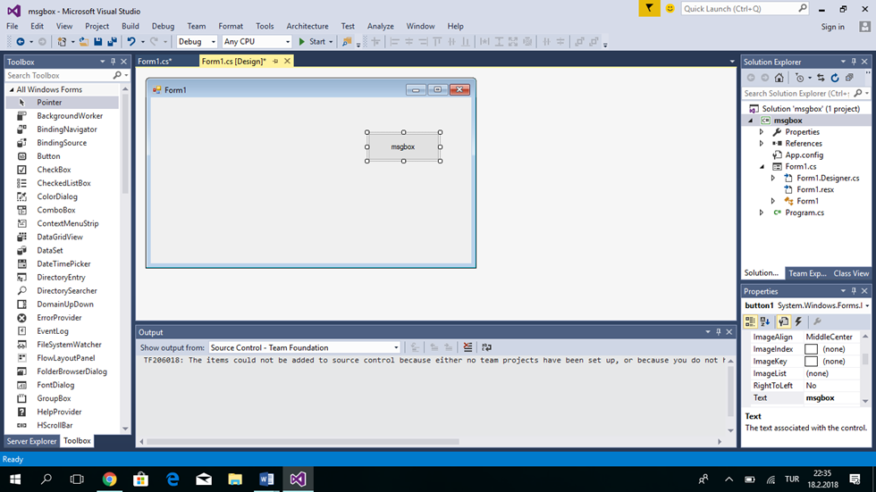

Slide 14
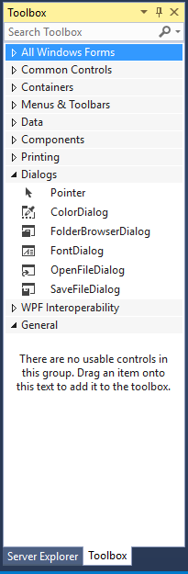
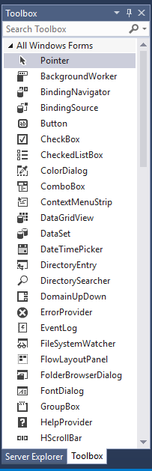
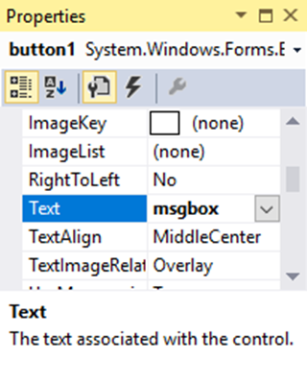
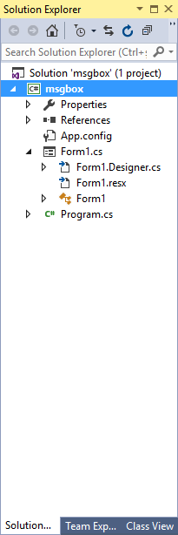

Slide 15
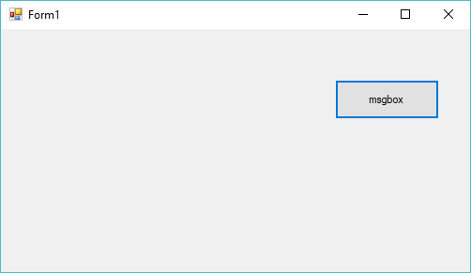
private void button1_Click(object sender, EventArgs e)
{
string msg;
msg = " ali \r";
msg = msg + " mehmet \n";
msg = msg + " ahmet ";
DialogResult sonuc1 = MessageBox.Show(msg, "a sınıf penceresi", MessageBoxButtons.OKCancel, MessageBoxIcon.Question);
if (sonuc1 == DialogResult.OK)
MessageBox.Show(" YOU PRESS THE OK BUTTON");
else
MessageBox.Show(" YOU PRESS THE Cancel BUTTON");
MessageBox.Show("The calculations are complete", "My Application", MessageBoxButtons.OKCancel, MessageBoxIcon.Asterisk);
}

Slide 16
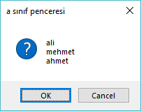
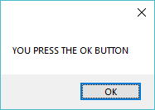
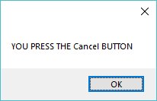
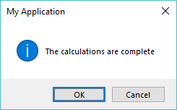
string msg;
msg = " ali \r";
msg = msg + " mehmet \n";
msg = msg + " ahmet ";
DialogResult sonuc1 = MessageBox.Show(msg, "a sınıf penceresi", MessageBoxButtons.OKCancel, MessageBoxIcon.Question);
else
MessageBox.Show(" YOU PRESS THE Cancel BUTTON");
if (sonuc1 == DialogResult.OK)
MessageBox.Show(" YOU PRESS THE OK BUTTON");
MessageBox.Show("The calculations are complete", "My Application", MessageBoxButtons.OKCancel, MessageBoxIcon.Asterisk);

Slide 17
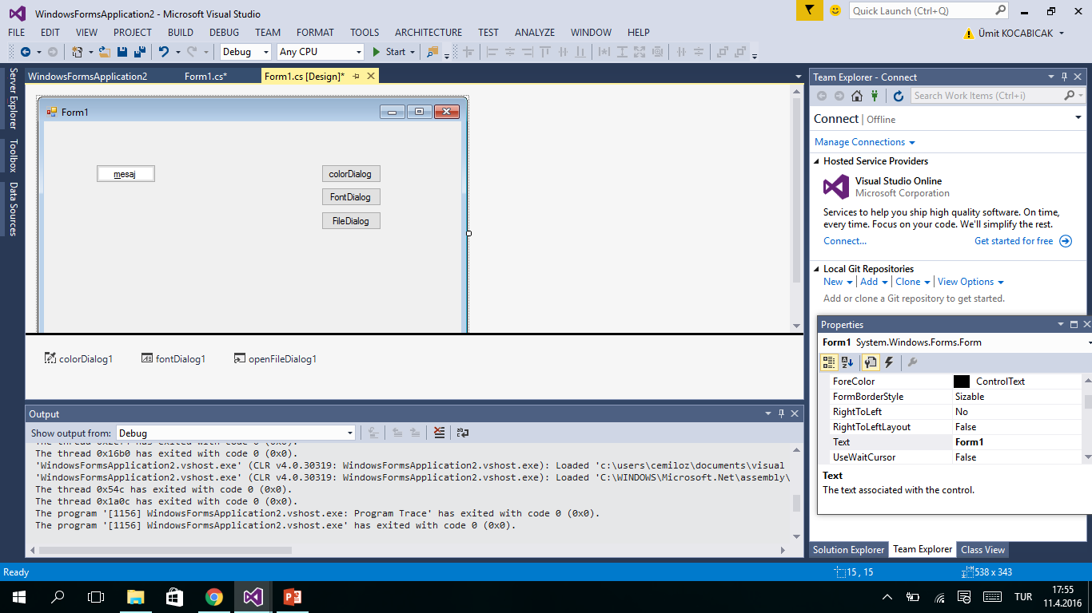
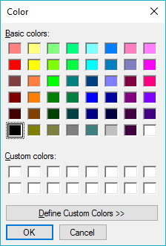
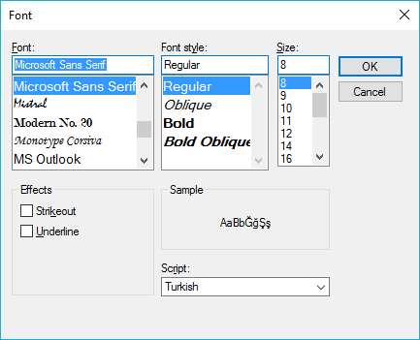
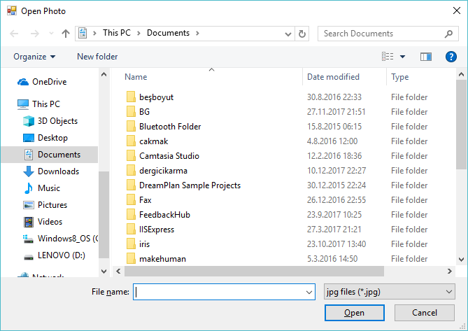

Slide 18
private void button1_Click(object sender, EventArgs e)
{
if (colorDialog1.ShowDialog() == DialogResult.OK)
{
this.BackColor = colorDialog1.Color;
}
}
private void button2_Click(object sender, EventArgs e)
{
if (fontDialog1.ShowDialog() == DialogResult.OK)
{
this.Font = fontDialog1.Font;
}
}
private void button3_Click(object sender, EventArgs e)
{
OpenFileDialog dlg = new OpenFileDialog();
dlg.Title = "Open Photo";
pictureBox1.SizeMode = PictureBoxSizeMode.StretchImage;
dlg.Filter = "jpg files (*.jpg)|*.jpg|All files (*.*)|*.*";
if (dlg.ShowDialog() == DialogResult.OK)
{
pictureBox1.Image = new Bitmap(dlg.OpenFile());
}
dlg.Dispose();
}

Slide 19
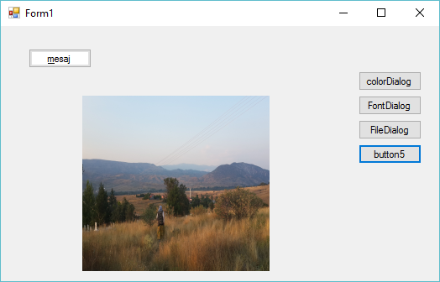

Slide 20
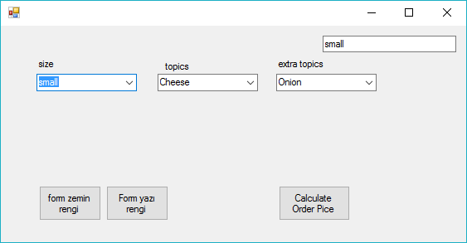
private void Form1_Load(object sender, EventArgs e)
{
label1.Text = "size";
label2.Text = "topics";
label3.Text = "extra topics";
comboBox2.Items.Add("small");
comboBox2.Items.Add("meddium");
comboBox2.Items.Add("large");
comboBox2.SelectedIndex=0;
comboBox3.Items.Add("Cheese");
comboBox3.Items.Add("meat lover");
comboBox3.Items.Add("Greek");
comboBox3.SelectedIndex = 0;
comboBox4.Items.Add("Onion");
comboBox4.Items.Add("beef");
comboBox4.Items.Add("cheese");
comboBox4.SelectedIndex = 0;
}

Slide 21
private void comboBox2_SelectedValueChanged(object sender, EventArgs e)
{
textBox1.Text = comboBox2.Text;
}

Slide 22
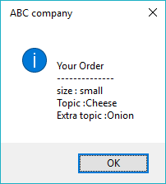
private void button1_Click(object sender, EventArgs e)
{
string msg = "\n Your Order \n --------------";
msg += "\n size : "+comboBox2.Text+"\n Topic :";
msg += comboBox3.Text + "\n Extra topic :";
msg += comboBox4.Text;
MessageBox.Show(msg," ABC company ", MessageBoxButtons.OK,MessageBoxIcon.Information);
}

Slide 23
private void button2_Click(object sender, EventArgs e)
{
ColorDialog cdlg = new ColorDialog();
if (cdlg.ShowDialog() == DialogResult.OK)
{
this.BackColor = cdlg.Color;
}
cdlg.Dispose();
}
private void button3_Click(object sender, EventArgs e)
{
colorDialog1.ShowDialog();
this.ForeColor = colorDialog1.Color;
}

Slide 24
private void button4_Click(object sender, EventArgs e)
{
FontDialog fdlg = new FontDialog();
if (fdlg.ShowDialog() == DialogResult.OK)
{
this.Font = fdlg.Font;
}
fdlg.Dispose();
}

Slide 25
using System;
using System.Collections.Generic;
using System.ComponentModel;
using System.Data;
using System.Drawing;
using System.Linq;
using System.Text;
using System.Threading.Tasks;
using System.Windows.Forms;
namespace form1
{
public partial class Form1 : Form
{
public Form1()
{
InitializeComponent();
}
private void Form1_Load(object sender, EventArgs e)
{
label1.Text = "size";
label2.Text = "topics";
label3.Text = "extra topics";
comboBox2.Items.Add("small");
comboBox2.Items.Add("meddium");
comboBox2.Items.Add("large");
comboBox2.SelectedIndex=0;
comboBox3.Items.Add("Cheese");
comboBox3.Items.Add("meat lover");
comboBox3.Items.Add("Greek");
comboBox3.SelectedIndex = 0;
comboBox4.Items.Add("Onion");
comboBox4.Items.Add("beef");
comboBox4.Items.Add("cheese");
comboBox4.SelectedIndex = 0;
}
private void comboBox2_SelectedValueChanged(object sender, EventArgs e)
{
textBox1.Text = comboBox2.Text;
}
private void button1_Click(object sender, EventArgs e)
{
string msg = "\n Your Order \n --------------";
msg += "\n size : "+comboBox2.Text+"\n Topic :";
msg += comboBox3.Text + "\n Extra topic :";
msg += comboBox4.Text;
MessageBox.Show(msg," ABC company ", MessageBoxButtons.OK,MessageBoxIcon.Information);
}
private void button2_Click(object sender, EventArgs e)
{
ColorDialog cdlg = new ColorDialog();
if (cdlg.ShowDialog() == DialogResult.OK)
{
this.BackColor = cdlg.Color;
}
cdlg.Dispose();
}
private void button3_Click(object sender, EventArgs e)
{
colorDialog1.ShowDialog();
this.ForeColor = colorDialog1.Color;
}
}
}

Slide 26
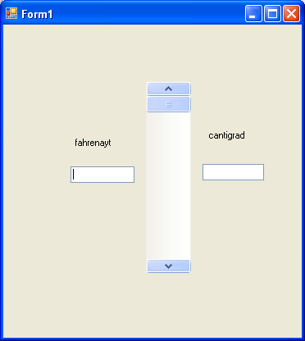
private void vScrollBar1_Scroll(object sender, ScrollEventArgs e)
{
int f;
Single c;
f = vScrollBar1.Value;
c = ((Single)5 / (Single)9) * ((System.Convert.ToSingle(f) - (Single)32));
textBox1.Text = System.Convert.ToString(f);
textBox2.Text = System.Convert.ToString(c);
}

Slide 27
if (f < 32)
{
panel1.BackColor = Color.Blue;
}
if (f >= 32 && f<60)
{
panel1.BackColor = Color.Green;
}
if (f >= 60 && f<80)
{
panel1.BackColor = Color.Yellow;
}
if (f >= 80)
{
panel1.BackColor = Color.Red;
}

Slide 28
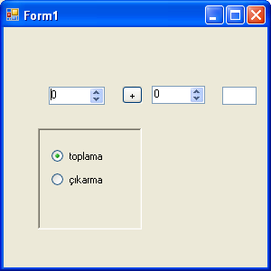

Slide 29
public partial class Form1 : Form
{
int a, b;
Single c;
public Form1()
private void radioButton1_CheckedChanged(object sender, EventArgs e)
{
textBox1.Text = " ";
button1.Text = "+";
}
private void radioButton2_CheckedChanged(object sender, EventArgs e)
{
textBox1.Text = " ";
button1.Text = "-";
}

Slide 30
private void numericUpDown1_ValueChanged(object sender, EventArgs e)
{
if (button1.Text == "+")
{
c = System.Convert.ToSingle(numericUpDown1.Value) + System.Convert.ToSingle(numericUpDown2.Value);
textBox1.Text = System.Convert.ToString(c);
}
if (button1.Text == "-")
{
c = System.Convert.ToSingle(numericUpDown1.Value) - System.Convert.ToSingle(numericUpDown2.Value);
textBox1.Text = System.Convert.ToString(c);
}
}

Slide 31
private void numericUpDown2_ValueChanged(object sender, EventArgs e)
{
if (button1.Text == "+")
{
c = System.Convert.ToSingle(numericUpDown1.Value) + System.Convert.ToSingle(numericUpDown2.Value);
textBox1.Text = System.Convert.ToString(c);
}
if (button1.Text == "-")
{
c = System.Convert.ToSingle(numericUpDown1.Value) - System.Convert.ToSingle(numericUpDown2.Value);
textBox1.Text = System.Convert.ToString(c);
}

Slide 32
using System;
using System.Windows.Forms;
namespace WindowsFormsApplication1
{
public partial class Form1 : Form
{
public Form1()
{
InitializeComponent();
}
private void Form1_Load(object sender, EventArgs e)
{
// Show the color dialog.
DialogResult result = colorDialog1.ShowDialog();
// See if user pressed ok.
if (result == DialogResult.OK)
{
// Set form background to the selected color.
this.BackColor = colorDialog1.Color;
}
}
}
}

Slide 33
using System;
using System.Drawing;
using System.Windows.Forms;
namespace WindowsFormsApplication1
{
public partial class Form1 : Form
{
public Form1()
{
InitializeComponent();
}
private void button1_Click(object sender, EventArgs e)
{
// Show the dialog.
DialogResult result = fontDialog1.ShowDialog();
// See if OK was pressed.
if (result == DialogResult.OK)
{
// Get Font.
Font font = fontDialog1.Font;
// Set TextBox properties.
this.textBox1.Text = string.Format("Font: {0}", font.Name);
this.textBox1.Font = font;
}
}
}
}

Slide 34
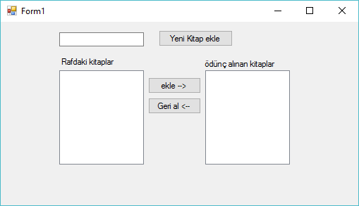
private void button1_Click(object sender, EventArgs e)
{
listBox1.Items.Add(textBox1.Text);
textBox1.Text = "";
textBox1.Focus();
}

Slide 35
private void button2_Click(object sender, EventArgs e)
{
listBox2.Items.Add(listBox1.SelectedItem);
listBox1.Items.Remove(listBox1.SelectedItem);
}

Slide 36
private void button3_Click(object sender, EventArgs e)
{
listBox1.Items.Add(listBox2.SelectedItem);
listBox2.Items.Remove(listBox2.SelectedItem);
}

Slide 37
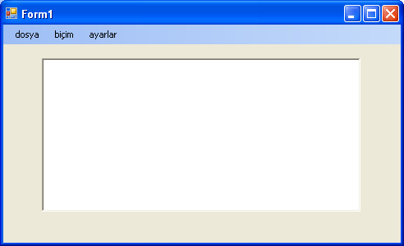
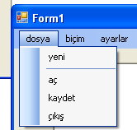
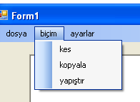
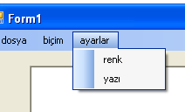
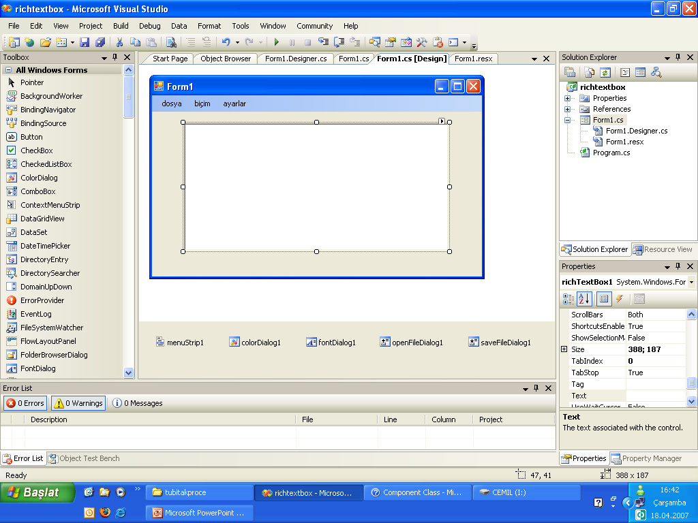

Slide 38
private void yeniToolStripMenuItem_Click(object sender, EventArgs e)
{
richTextBox1.Text = " ";
}
private void açToolStripMenuItem_Click(object sender, EventArgs e)
{
if ( openFileDialog1.ShowDialog() == DialogResult.OK)
{
richTextBox1.LoadFile(openFileDialog1.FileName);
}
}
private void kaydetToolStripMenuItem_Click(object sender, EventArgs e)
{
if ( saveFileDialog1.ShowDialog() == DialogResult.OK)
{
richTextBox1.SaveFile(saveFileDialog1.FileName, RichTextBoxStreamType.RichText);
}
}

Slide 39
private void çıkışToolStripMenuItem_Click(object sender, EventArgs e)
{
Close();
}
private void kesToolStripMenuItem_Click(object sender, EventArgs e)
{
richTextBox1.Cut();
}
private void kopyalaToolStripMenuItem_Click(object sender, EventArgs e)
{
richTextBox1.Copy();
}
private void yapıştırToolStripMenuItem_Click(object sender, EventArgs e)
{
richTextBox1.Paste();
}

Slide 40
private void renkToolStripMenuItem_Click(object sender, EventArgs e)
{
colorDialog1.ShowDialog();
richTextBox1.ForeColor = colorDialog1.Color;
}
private void yazıToolStripMenuItem_Click(object sender, EventArgs e)
{
if (fontDialog1.ShowDialog() == DialogResult.OK)
{
richTextBox1.Font = fontDialog1.Font;
}
}
private void yazıToolStripMenuItem_Click(object sender, EventArgs e)
{
fontDialog1.ShowDialog();
richTextBox1.Font = fontDialog1.Font;
}

Slide 41
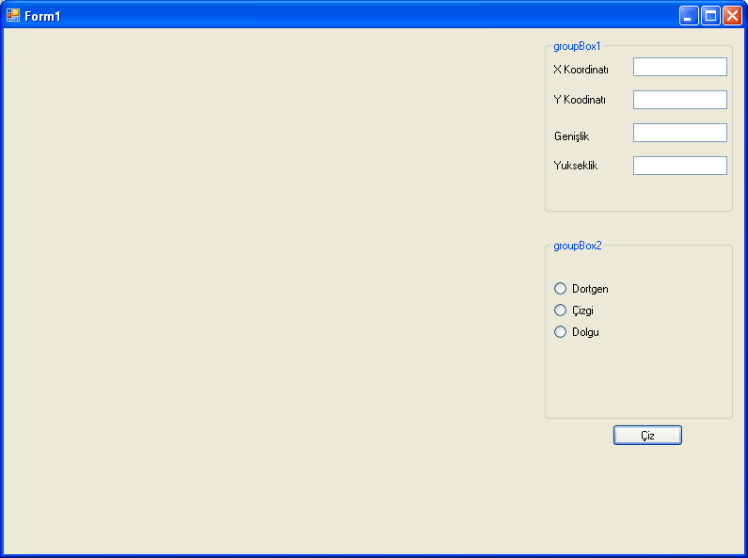

Slide 42
private void button1_Click(object sender, EventArgs e)
{
Graphics cizim;
cizim = this.CreateGraphics();
Pen kalem = new Pen(Color.Green, 2);
SolidBrush firca=new SolidBrush(Color.Red);
if (rbdRec.Checked==true)
cizim.DrawRectangle (kalem, Convert.ToInt32(txtXK.Text), Convert.ToInt32(txtYK.Text),
Convert.ToInt32(txtG.Text), Convert.ToInt32(txtY.Text));
if (rbdLine.Checked == true)
cizim.DrawLine(kalem, Convert.ToInt32(txtXK.Text), Convert.ToInt32(txtYK.Text),
Convert.ToInt32(txtG.Text), Convert.ToInt32(txtY.Text));
if (rbddolu.Checked == true)
cizim.FillRectangle (firca, Convert.ToInt32(txtXK.Text), Convert.ToInt32(txtYK.Text),
Convert.ToInt32(txtG.Text), Convert.ToInt32(txtY.Text));
}

Slide 43
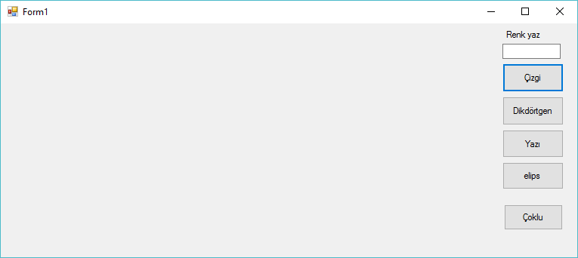

Slide 44
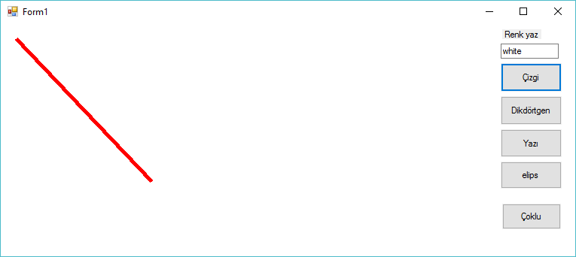
private void button1_Click(object sender, EventArgs e)
{
System.Drawing.Graphics graphicsObj;
graphicsObj = this.CreateGraphics();
Color a = Color.FromName(textBox1.Text);
graphicsObj.Clear(a);
Pen myPen = new Pen(System.Drawing.Color.Red, 5);
graphicsObj.DrawLine(myPen, 20, 20, 200, 210);
}

Slide 45
private void button2_Click(object sender, EventArgs e)
{
System.Drawing.Graphics graphicsObj;
graphicsObj = this.CreateGraphics();
Pen myPen = new Pen(System.Drawing.Color.Red, 5);
Rectangle myRectangle = new Rectangle(20, 20, 250, 200);
graphicsObj.DrawRectangle(myPen, myRectangle);
}
private void button3_Click(object sender, EventArgs e)
{
System.Drawing.Graphics graphicsObj;
graphicsObj = this.CreateGraphics();
Font myFont = new System.Drawing.Font("Helvetica", 40, FontStyle.Italic);
Brush myBrush = new SolidBrush(System.Drawing.Color.Red);
graphicsObj.DrawString("Hello C#", myFont, myBrush, 30, 30);
}
private void button4_Click(object sender, EventArgs e)
{
System.Drawing.Graphics graphicsObj;
graphicsObj = this.CreateGraphics();
Pen myPen = new Pen(System.Drawing.Color.Green, 5);
Rectangle myRectangle = new Rectangle(20, 20, 250, 200);
graphicsObj.DrawEllipse(myPen, myRectangle);
}

Slide 46
private void button5_Click(object sender, EventArgs e)
{
// render list contains all shapes
List<Rectangle> DrawList = new List<Rectangle>();
// add example data
DrawList.Add(new Rectangle(10, 30, 10, 40));
DrawList.Add(new Rectangle(50, 40, 20, 10));
DrawList.Add(new Rectangle(20, 20, 30, 20));
// draw
Graphics g = this.CreateGraphics();
foreach (Rectangle Object in DrawList)
{
g.FillRectangle(new SolidBrush(Color.Black), Object);
}
}

Slide 47
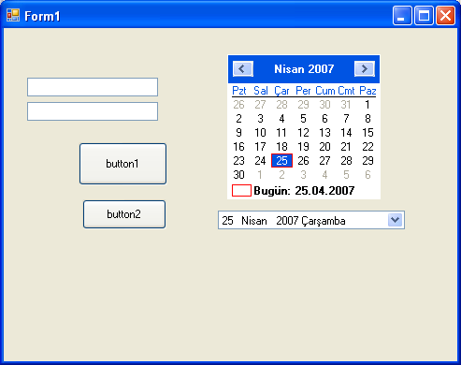

Slide 48
private void button1_Click(object sender, EventArgs e)
{
monthCalendar1.BackColor = Color.Red;
monthCalendar1.ForeColor = Color.Green;
textBox1.Text = System.Convert.ToString( monthCalendar1.TodayDate);
}
private void button2_Click(object sender, EventArgs e)
{
this.dateTimePicker1.CustomFormat = "HH-mm-ss : MMMM/dd/yyyy tt";
this.dateTimePicker1.Format = System.Windows.Forms.DateTimePickerFormat.Custom;
this.dateTimePicker1.Location = new System.Drawing.Point(200, 200);
this.dateTimePicker1.Name = "dateTimePicker";
this.dateTimePicker1.Size = new System.Drawing.Size(240, 20);
this.dateTimePicker1.TabIndex = 0;
dateTimePicker1.CalendarForeColor = Color.Red;
dateTimePicker1.CustomFormat = " MMMM/dddd/yy";
}

Slide 49
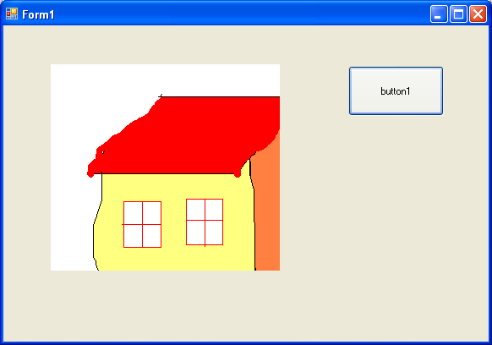

Slide 50
private void button1_Click(object sender, EventArgs e)
{
OpenFileDialog open = new OpenFileDialog();
open.Filter = "Image Files(*.jpg; *.jpeg; *.gif; *.bmp)|*.jpg; *.jpeg; *.gif; *.bmp";
if (open.ShowDialog() == DialogResult.OK)
{
pictureBox1.Image = new Bitmap(open.FileName);
}
}

Slide 51
private void button2_Click(object sender, EventArgs e)
{
pictureBox1.SizeMode = System.Windows.Forms.PictureBoxSizeMode.StretchImage;
}
private void button3_Click(object sender, EventArgs e)
{
pictureBox1.SizeMode = System.Windows.Forms.PictureBoxSizeMode.AutoSize;
}
private void button4_Click(object sender, EventArgs e)
{
pictureBox1.SizeMode = System.Windows.Forms.PictureBoxSizeMode.CenterImage;
}

Slide 52
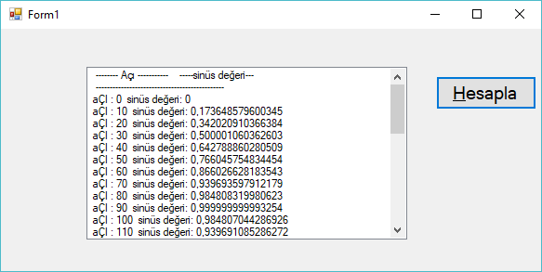
private void button1_Click(object sender, EventArgs e)
{
int aci;
double sin_deg,radyan;
listBox1.Items.Add(" ---- Açı -- -----sinüs değeri---") ;
listBox1.Items.Add(" -----------------------------------");
for (aci = 0; aci <= 360; aci++)
{
radyan=System.Convert.ToDouble (aci) * 3.1416 / 180.00;
sin_deg = Math.Sin(radyan );
listBox1.Items.Add(" aÇI : " + System.Convert.ToString(aci) + " sinüs değeri: " + System.Convert.ToString(sin_deg));
}
}

Slide 53
private void radioButton1_CheckedChanged(object sender, EventArgs e)
{
if (colorDialog1.ShowDialog() == DialogResult.OK)
{
button1.ForeColor = colorDialog1.Color;
}
}
private void radioButton2_CheckedChanged(object sender, EventArgs e)
{
if (colorDialog1.ShowDialog() == DialogResult.OK)
{
button1.BackColor = colorDialog1.Color;
}
}

Slide 54
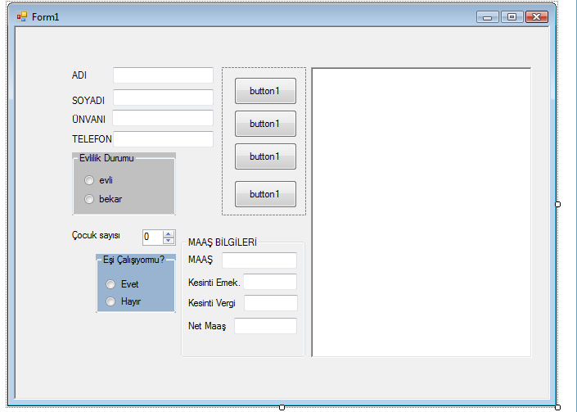

Slide 55
public partial class Form1 : Form
{
Single maas, kesinti, emekli, netmaas;
public Form1()
{
InitializeComponent();
}
private void radioButton2_CheckedChanged(object sender, EventArgs e)
{
groupBox2.Enabled = false;
hesapla();
}
private void radioButton1_CheckedChanged(object sender, EventArgs e)
{
groupBox2.Enabled = true ;
hesapla();
}

Slide 56
string msg1,msg;
int a, b;
msg = textBox1.Text;
b = msg.Length;
msg1 = msg.Substring(0, b);
for (a = b ; a <= 10; a++)
{
msg1 = msg1 + "_";
}
richTextBox1.Text = msg1;
msg = textBox2.Text;
b = msg.Length;
msg1 = msg.Substring(0, b);
for (a = b; a <= 10; a++)
{
msg1 = msg1 + "_";
}
richTextBox1.Text =richTextBox1 .Text + msg1;
msg = textBox3.Text;
b = msg.Length;
msg1 = msg.Substring(0, b);
for (a = b; a <= 10; a++)
{
msg1 = msg1 + "_";
}
richTextBox1.Text = richTextBox1 .Text + msg1;

Slide 57
private void textBox5_TextChanged(object sender, EventArgs e)
{
maas = System.Convert.ToSingle (textBox5.Text);
kesinti = maas * (Single )0.10;
emekli = maas * (Single)0.20;
netmaas = maas - kesinti - emekli;
textBox6.Text = System.Convert.ToString(emekli);
textBox7.Text = System.Convert.ToString(kesinti);
textBox8.Text = System.Convert.ToString(netmaas);
}

Slide 58
private void hesapla()
{
maas = System.Convert.ToSingle(0);
if (radioButton1.Checked)
{
if (radioButton4.Checked)
maas = System.Convert.ToSingle(800);
}
if (radioButton1.Checked)
{
if (radioButton3.Checked)
maas = System.Convert.ToSingle(700);
}
if (radioButton2.Checked)
{
maas = System.Convert.ToSingle(700);
}
if(numericUpDown1.Value==1)
maas = maas + System.Convert.ToSingle(30);
if (numericUpDown1.Value > 1)
maas = maas + System.Convert.ToSingle(60);
textBox5.Text = System.Convert.ToString(maas);
}

Slide 59
private void numericUpDown1_ValueChanged(object sender, EventArgs e)
{
hesapla();
}
private void radioButton3_CheckedChanged(object sender, EventArgs e)
{
hesapla();
}
private void radioButton4_CheckedChanged(object sender, EventArgs e)
{
hesapla();
}

Slide 60
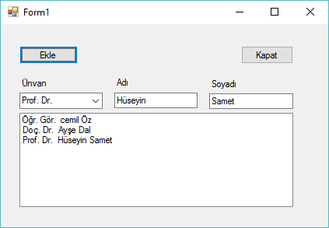
private void Form1_Load(object sender, EventArgs e)
{
comboBox1.Items.Add("Uzman ");
comboBox1.Items.Add("Arş. Gör. ");
comboBox1.Items.Add("Öğr. Gör. ");
comboBox1.Items.Add("Yrd. Doç. Dr. ");
comboBox1.Items.Add("Doç. Dr. ");
comboBox1.Items.Add("Prof. Dr. ");
}

Slide 61
private void button2_Click(object sender, EventArgs e)
{
string unvan = comboBox1.Text;
string adi = textBox1.Text;
string soyAdi = textBox2.Text;
listBox1.BeginUpdate();
listBox1.Items.Add(unvan + " " + adi + " " + soyAdi);
listBox1.EndUpdate();
}

Slide 62
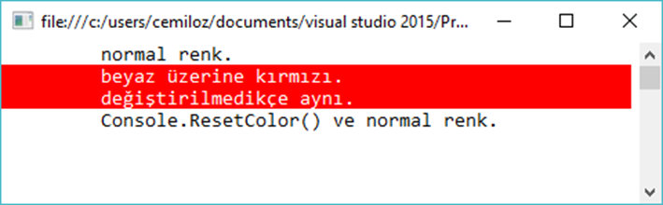
using System;
using System.Text;
namespace renk
{
class Program
{
static void Main(string[] args)
{
Console.WriteLine("\t normal renk. ");
Console.BackgroundColor = ConsoleColor.Red;
Console.ForegroundColor = ConsoleColor.White;
Console.WriteLine("\t beyaz üzerine kırmızı.");
// beya üzerine kırmızı devam edecektir
Console.WriteLine("\t değiştirilmedikçe aynı.");
// normal renk'e dönüş
Console.ResetColor();
Console.WriteLine("\t Console.ResetColor() ve normal renk. ");
Console.ReadKey();
}
}
}

Slide 63
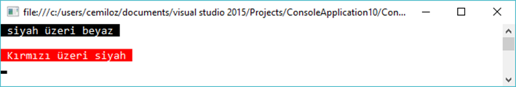
using System;
using System.Text;
namespace renk
{
class Program
{
static void Main(string[] args)
{
//
Console.BackgroundColor = ConsoleColor.Black;
Console.ForegroundColor = ConsoleColor.White;
Console.WriteLine(" siyah üzeri beyaz ");
Console.WriteLine();
if (Console.BackgroundColor == ConsoleColor.Black)
{
Console.BackgroundColor = ConsoleColor.Red;
Console.ForegroundColor = ConsoleColor.White;
Console.WriteLine(" Kırmızı üzeri siyah ");
}
Console.ReadKey();
}
}
}

Slide 64
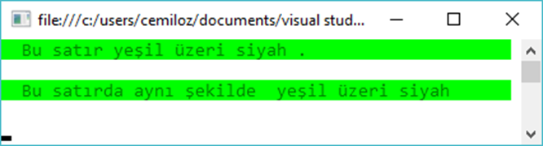
using System;
using System.Text;
namespace renk
{
class Program
{
static void Main(string[] args)
{
// yeşil(green) satır.
//
Yazdir(" Bu satır yeşil üzeri siyah .");
Console.WriteLine();
// bir defa daha metodu çağır
Yazdir(" Bu satırda aynı şekilde yeşil üzeri siyah");
Console.WriteLine();
Console.ReadKey();
}
static void Yazdir(string value)
{
// Yeşil zemin üzerine siyah yazı
Console.BackgroundColor = ConsoleColor.Green;
Console.ForegroundColor = ConsoleColor.DarkGreen;
Console.WriteLine(value.PadRight(Console.WindowWidth - 1));
// renk sıfırlanmakta
Console.ResetColor();
}
}
}

Slide 65
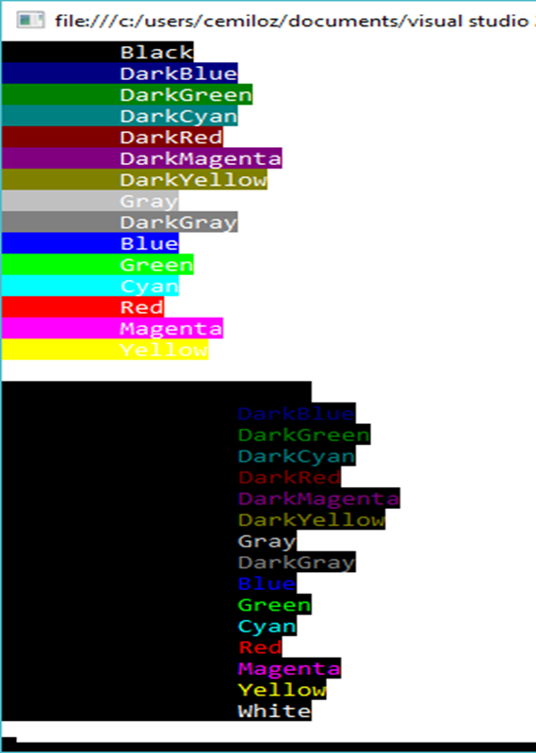
using System;
using System.Text;
namespace renk
{
class Program
{
static void Main(string[] args)
{
//
// zemin ve yazı için renk örnekği
//
Type tip = typeof(ConsoleColor);
Console.ForegroundColor = ConsoleColor.White;// yazı beyaz
foreach (var renkAdi in Enum.GetNames(tip))
{
Console.BackgroundColor = (ConsoleColor)Enum.Parse(tip, renkAdi);
Console.WriteLine("\t" + renkAdi);
}
Console.BackgroundColor = ConsoleColor.Black; // zemin siyah
foreach (var renkAdi in Enum.GetNames(tip))
{
Console.ForegroundColor = (ConsoleColor)Enum.Parse(tip, renkAdi);
Console.WriteLine("\t\t"+ renkAdi);
}
Console.ReadKey();
}
}
}

